Slide 1
軟體工程期末報告
第一組: 105598003 劉彥麟 105598069 楊雅雯 106598038 李柏霖 106598048 郭士銓 106598053 陳韻文

Slide 2
Overall Project Deliverables
01
Outline
Personal Evaluation to Project Contributions
02
Analysis and Design Models
03
Overall Project Deliverables
04
Change History of The Project
05
Evaluation to Consistency of Design and Implementation
06
Project retrospective

Slide 3
1
Personal Evaluation To Project Contribution

Slide 4
Personal Evaluation to Project Contributions
成員 | 測試 | 開發 | 文件 | CI維護
劉彥麟 | 20％ | 32% | 20％ | 20％
楊雅雯 | 20% | 17% | 20％ | 20％
陳韻文 | 20％ | 17% | 20％ | 20％
李柏霖 | 20％ | 17% | 20％ | 20％
郭士銓 | 20％ | 17% | 20％ | 20％
工作項目
Part 2
点击此处添加标题
Part 4
点击此处添加标题

Slide 5
2
Analysis and Design Models

Slide 6
Use Case Diagram
批改作業

Slide 7
Sequence Diagram (人工批改作業)

Slide 8
Sequence Diagram (Jenkins自動批改作業)

Slide 9
3
Overall Project Deliverables

Slide 10
Overall Project Deliverables
1
Project Execute Plan(PEP)
2
System Requirement Specification(SRS)。
3
System Development Document(SDD)
4
System Testing Document(STD) 。
5
Source code: https://github.com/LeoLiu1209/Node-PASS
6
Automated testing script(Selenium)

Slide 11
4
Change History of The Project

Slide 12
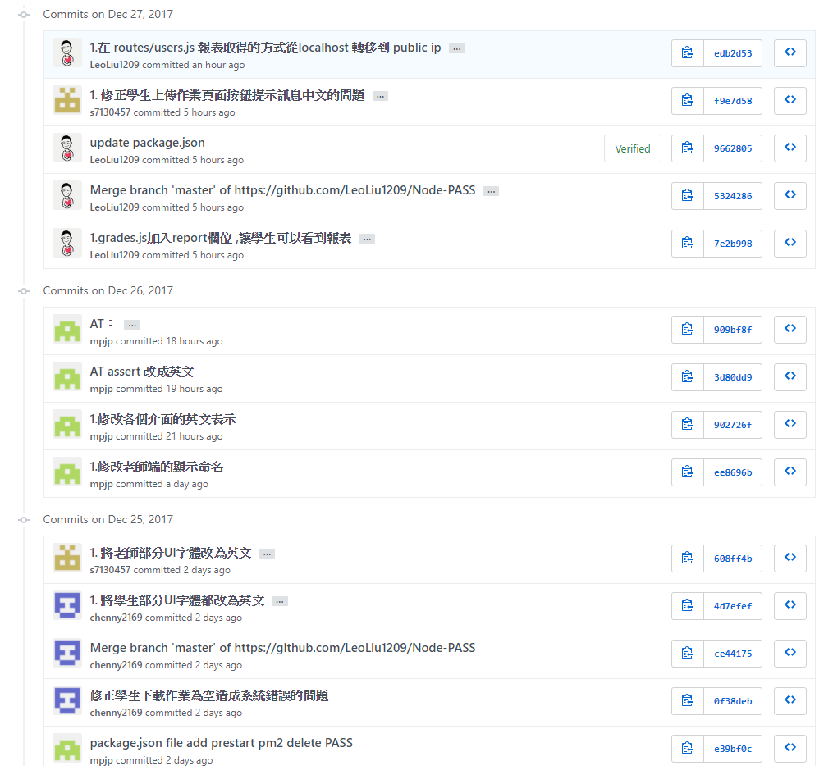

Change History of The Project
COMPANY | LOGO

Slide 13
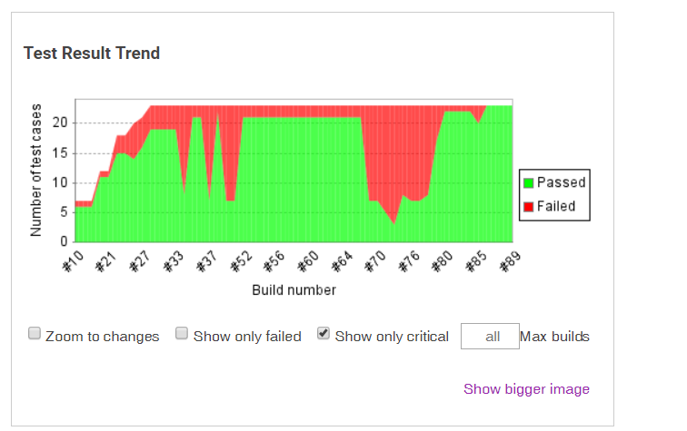

Change History of The Project
造成重大FAIL的原因 :
#33 權限未設定完全
#37 Jenkin設定改變
#64-76資料庫未清乾淨
#64-76更改介面內容，但AT未更新

Slide 14
5
Evaluation to Consistency of Design and Implementation

Slide 15
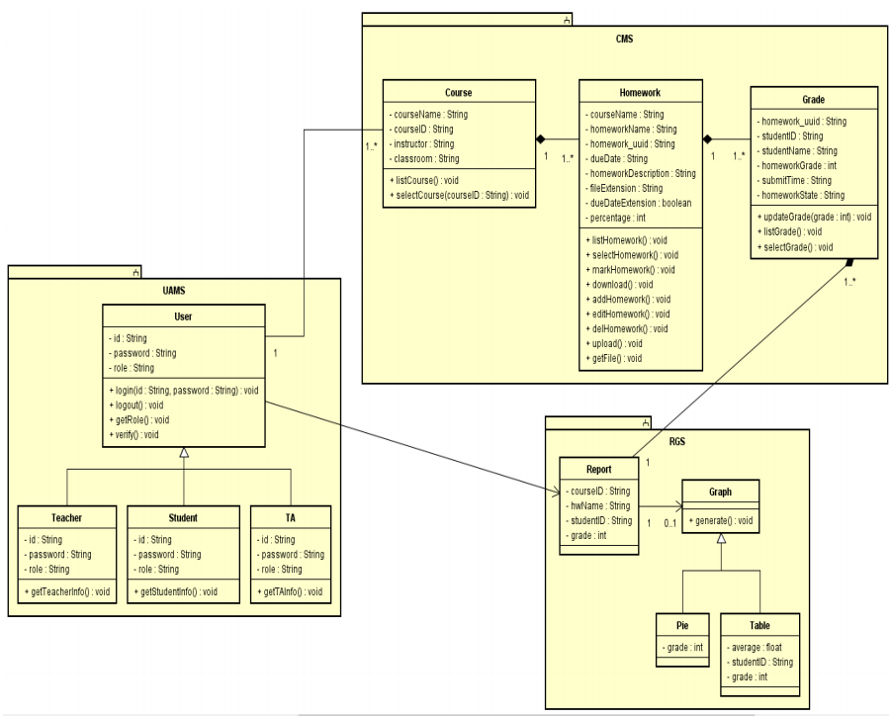
Evaluation to Consistency of Design and Implementation

Slide 16
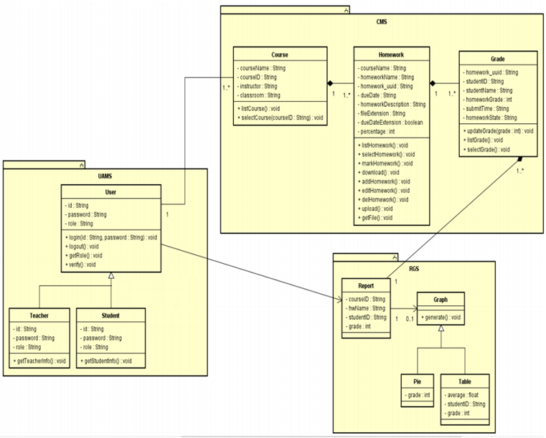
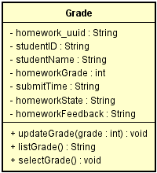
Evaluation to Consistency of Design and Implementation

Slide 17
6
Project retrospective

Slide 18
Project retrospective
Good
Could be better
1. 每天都有daily Scrum
2. 有持續整合
3. 有自動化測試
1.開成一個STORY
2. PUSH 前要先找人看過
3.更改程式前需確認測試內容
4.每天確認測試情況
COPANY | LOGO

Slide 19
DEMO

Slide 20

OfficePLUS
背景图片素材

